Slide 1
God’s Family, God’s Government
God’s Order
Ludwig
18/11/18

Slide 2
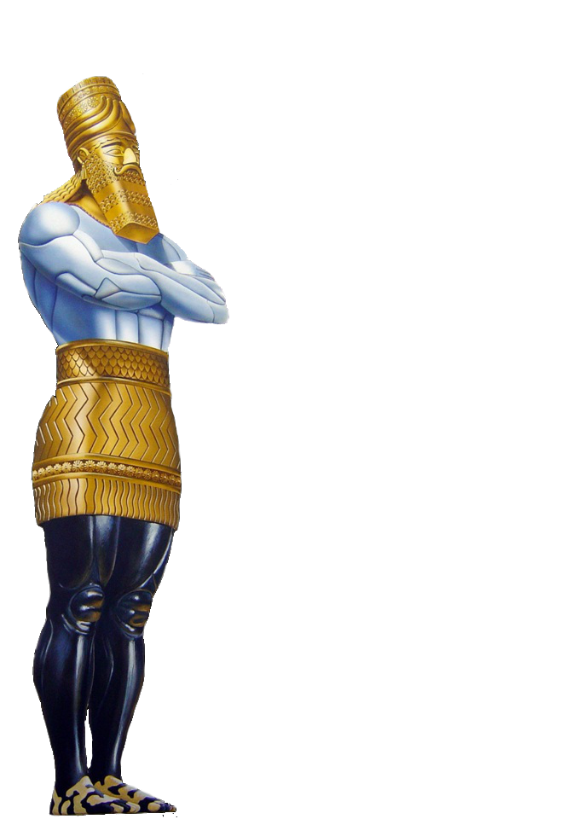



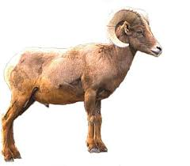
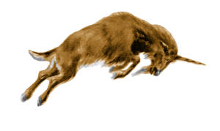


World Kingdoms
Daniel 2
(Metallic Kingdoms of the World)
WORLD
KINGDOMS
Daniel 7
(Beast Kingdoms of the world)
Daniel 8
GOLD
BABYLON
(Iraq)
LION
had eagle's wings
MEDO-PERSIA
(Iran)
SILVER
BEAR
- had 3 ribs
Ram
BRASS
LEOPARD
- have 4 wings of a fowl
- also had four heads
GREECE
He-Goat
LEGS OF IRON
ROME
TERRIBLE BEAST
- Dreadful & terrible
- had ten horns
10 TOES
IRON & CLAY
10 Kings
|
ANTI-CHRIST
10 HORNS
& LITTLE HORN

Slide 3
Daniel 2:36-45
³⁶ “This is the dream. Now we will tell the interpretation of it before the king.
³⁷ You, O king, are a king of kings. For the God of heaven has given you a kingdom, power, strength, and glory;
³⁸ and wherever the children of men dwell, or the beasts of the field and the birds of the heaven, He has given them into your hand, and has made you ruler over them all—you are this head of gold.
³⁹ But after you shall arise another kingdom inferior to yours; then another, a third kingdom of bronze, which shall rule over all the earth.

Slide 4
⁴⁰ And the fourth kingdom shall be as strong as iron, inasmuch as iron breaks in pieces and shatters everything; and like iron that crushes, that kingdom will break in pieces and crush all the others.
⁴¹ Whereas you saw the feet and toes, partly of potter’s clay and partly of iron, the kingdom shall be divided; yet the strength of the iron shall be in it, just as you saw the iron mixed with ceramic clay.
⁴² And as the toes of the feet were partly of iron and partly of clay, so the kingdom shall be partly strong and partly fragile.

Slide 5
⁴³ As you saw iron mixed with ceramic clay, they will mingle with the seed of men; but they will not adhere to one another, just as iron does not mix with clay.
⁴⁴ And in the days of these kings the God of heaven will set up a kingdom which shall never be destroyed; and the kingdom shall not be left to other people; it shall break in pieces and consume all these kingdoms, and it shall stand forever.
⁴⁵ Inasmuch as you saw that the stone was cut out of the mountain without hands, and that it broke in pieces the iron, the bronze, the clay, the silver, and the gold—the great God has made known to the king what will come to pass after this. The dream is certain, and its interpretation is sure.”

Slide 6
Isaiah 9:7
⁷ Of the increase of His government and peace
There will be no end,
Upon the throne of David and over His kingdom,
To order it and establish it with judgment and justice
From that time forward, even forever.
The zeal of the Lord of hosts will perform this.

Slide 7
Ephesians 5:25-32
²⁵ Husbands, love your wives, just as Christ also loved the church and gave Himself for her,
²⁶ that He might sanctify and cleanse her with the washing of water by the word,
²⁷ that He might present her to Himself a glorious church, not having spot or wrinkle or any such thing, but that she should be holy and without blemish.
²⁸ So husbands ought to love their own wives as their own bodies; he who loves his wife loves himself.

Slide 8
²⁹ For no one ever hated his own flesh, but nourishes and cherishes it, just as the Lord does the church.
³⁰ For we are members of His body, of His flesh and of His bones.
³¹ “For this reason a man shall leave his father and mother and be joined to his wife, and the two shall become one flesh.”
³² This is a great mystery, but I speak concerning Christ and the church.

Slide 9
Ephesians 4:4-6
⁴ There is one body and one Spirit, just as you were called in one hope of your calling;
⁵ one Lord, one faith, one baptism;
⁶ one God and Father of all, who is above all, and through all, and in you all.

Slide 10
The Church
For Christ to present to Himself a GLORIOUS Church
Bride without spot
without wrinkle
without blemish
Holy
Perfect

